Slide 1
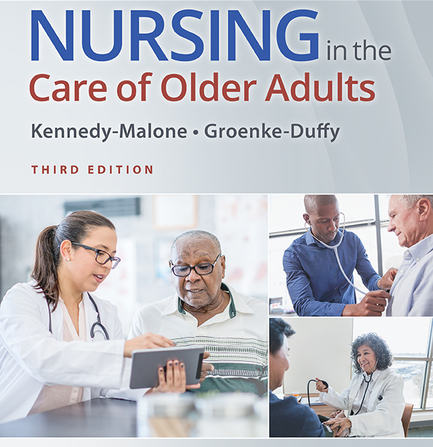
Assigned readings (see course outline) Common Cardiovascular disorders in the elderly Chapter: 7 (chest pain) Chapter 10: CV disorders Revised and updated Dr. Delacroix 2023

Slide 2
Assessment of the Cardiovascular System (taped)
Key symptoms
Dizziness
Syncope
Orthopnea
Angina
Edema
Claudication
Differentiating normal from abnormal function in older adults

Slide 3
CVD RISK FACTORS
Four major risk factors for CVD:
Hypertension
Diabetes mellitus
Dyslipidemia
Smoking
Higher rates of CVD in older people: absolute number of cases per risk factor tends to increase with age
Multiple risk factors act in concert with age-related CV changes to promote the development and progression of heart and vascular disorders

Slide 4
PRINCIPAL EFFECTS OF AGING ON THE CARDIOVASCULAR SYSTEM (1 of 2)
Age effect | Clinical implication
↑ Arterial stiffness | ↑ Afterload and systolic BP
↓ Myocardial relaxation & compliance | ↑ Risk of diastolic heart failure and atrial fibrillation
Impaired responsiveness to β-adrenergic stimulation | ↓ Maximum cardiac output; impaired thermoregulation
↓ Sinus node function and conduction velocity in the atrioventricular node and infranodal conduction system | ↑ Risk of sick sinus syndrome, left anterior fascicular block, and bundle branch block

Slide 5
PRINCIPAL EFFECTS OF AGING ON THE CARDIOVASCULAR SYSTEM (2 of 2)
Age effect | Clinical implication
Impaired endothelium-dependent vasodilation | ↑ Demand ischemia and risk of coronary artery disease and peripheral arterial disease
↓ Baroreceptor responsiveness | ↑ Risk of orthostatic hypotension
↓ Exercise response (↓ maximal heart rate, maximal cardiac output, VO₂ max, coronary blood flow, peripheral vasodilation) | ↓ Exercise capacity and ↑ cardiac complications (ischemia, heart failure, shock, arrhythmias, death) with illness

Slide 6
CLINICAL EFFECTS OF CV CHANGES
In healthy older adults, age-related changes have modest clinically relevant effects on cardiac hemodynamics and performance at rest
Resting heart rate, ejection fraction, stroke volume, and cardiac output are well preserved even at very advanced age
Ability to respond to increased demands associated with exercise or illness (either cardiac or noncardiac) declines progressively with advancing age
Peak aerobic capacity declines inexorably with age

Slide 7
Hypertension
High prevalence of HTN only a third of elderly patients meets B/P target recommendations.
symptoms
Often asymptomatic
If symptomatic: headache, CP, dyspnea or vision changes
Description
Classified as essential or secondary

Slide 8
Hypertension
Incidence:
Affect 86 millions U.D. Adults 20 years or older
Increase with age
Half hypertensive patients are not well controlled
15% of hypertensive patients are not even aware they have HTN.
Up to 95% are diagnosed with essential hypertension
Higher in AA, with higher mortality rate
Benefits of HTN control:
Reduction of 10 mmhg systolic and 5 mmhg diastolic at age 65 associated with
Reduction of 25% of MI, 40% stroke, 50% CHF, up to 20% mortality.
Current HTN control remains extremely low despite obvious benefits.

Slide 9
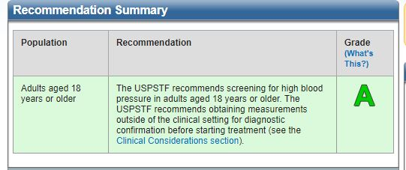

Slide 10
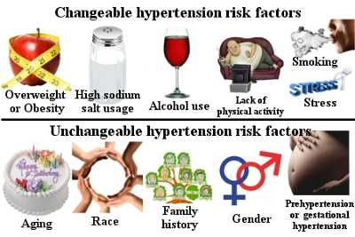
HTN: Risk factors

Slide 11
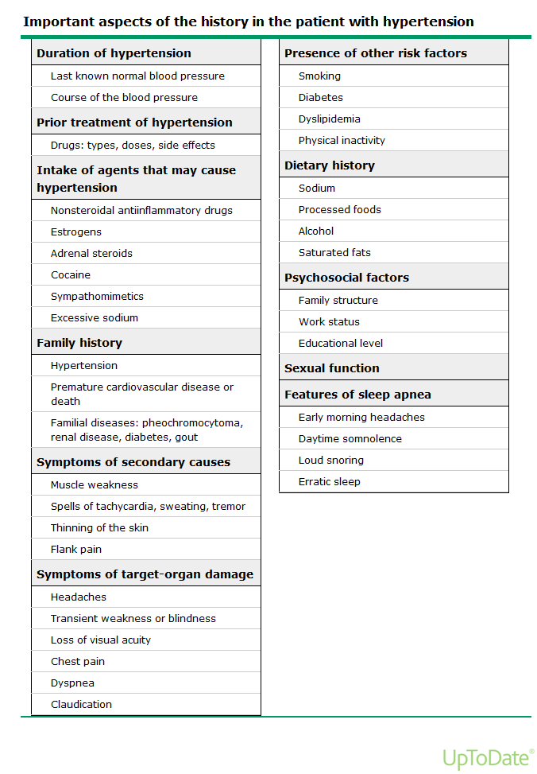

Slide 12
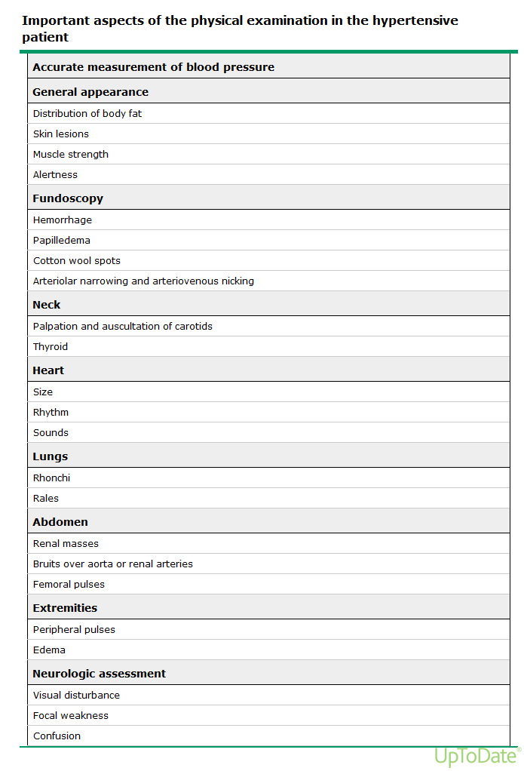

Slide 13

Diagnosing
All adults 18 years and older without known HTN should be screened for elevated BP (USPSTF et al., 2021).
To diagnose HTN the provider should use an average of two or more readings obtained on two or more occasions Out of office BP measurements (ambulatory or home BP monitoring) are recommended to confirm the diagnosis of HTN before starting treatment
(USPSTF et al., 2021).

Slide 14
JNC8, ACC/AHA guidelines…. OMG! Confusion confusion Updates in 2023 after years of resistance, primary care is slowly abandoning JNC8 guidelines and adopting the ACC/AHA 2017 guidelines

Slide 15
American Academy of Nurse practitioners 2017 ACC/AHA and JNC-8 hypertension guidelines
FYI: September 2018 - The American College of Cardiology (ACC) / American Heart Association (AHA) hypertension guideline published in November 2017 introduced new blood-pressure categories lowering the threshold for the diagnosis of hypertension. Items on each of the AANPCB certification examinations are reviewed each year by clinical experts for relevancy to current and best practice. The 2018 certification examinations use the 2017 ACC/AHA and JNC-8 guidelines to reference test items. While treatment targets may differ among various guidelines, it is important to keep evaluation of the individual's health as the central concern.

Slide 16
Diagnosis of HTN according to JNC8 Followed by AAFP and
A diagnosis of HTN should be made under the following circumstances:
Age <60 years: SBP ≥140 mm Hg and/or DBP ≥90 mm Hg at ≥2 visits
Age 60 years or older: SBP ≥150 mm Hg and/or DBP ≥90 mm Hg at ≥2 visits
Age 60 years or older with CKD or diabetes: SBP ≥140 mm Hg and/or DBP ≥90 mm Hg at ≥2 visits
Pre-hypertension
SBP ≥120 mm Hg and/or DBP ≥80 mm Hg at ≥2 visits

Slide 17
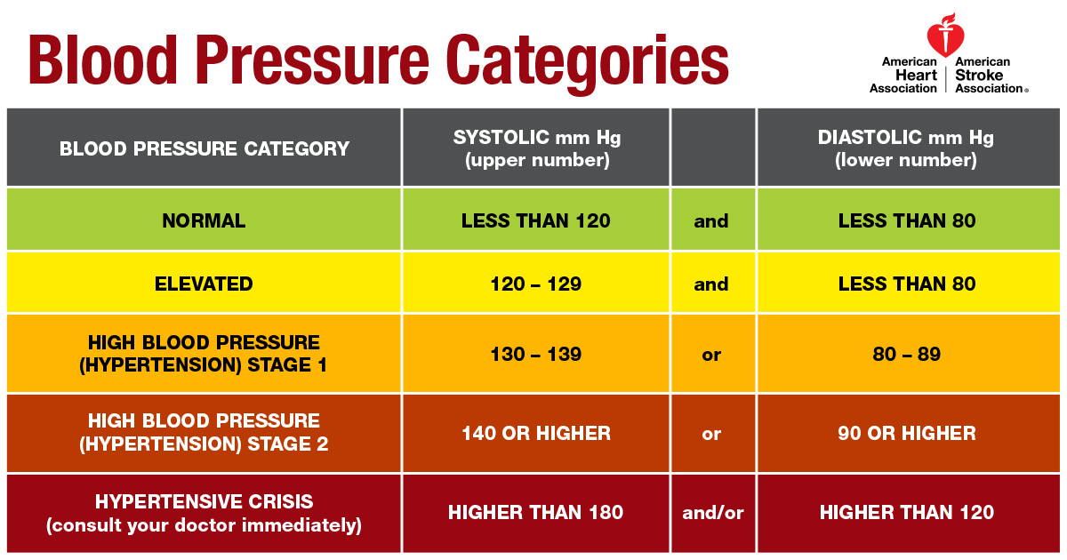
blood pressure classification acc/aha: 2017

Slide 18
Diagnostics: Hypertension
Initial Tests (lab, imaging)
Hemoglobin or hematocrit or CBC
Complete urinalysis (may reveal proteinuria, check kidney function)
CMP (Potassium, calcium, creatinine), and uric acid
TSH
Lipid panel (total, HDL, LDL, triglyceride [TG])
Fasting blood glucose or hemoglobin A1c
Urinalysis (to evaluate albumin/creatinine ration)
EKG to evaluate possible presence of left ventricular hypertrophy (LVH) or rhythm abnormalities,
Follow-Up Tests & Special Considerations
consider echocardiogram stress test if initial diagnostic test are abnormal.
Special tests only if suggested by history, physical, or labs. In particular, consider possibility of sleep apnea.
Ambulatory (24-hour) BP monitoring if “white coat” HTN is suspected, episodic HTN, or autonomic dysfunction
Home BP monitoring is effective, especially when white coat HTN is a consideration; elevated home BPs correlate with adverse outcomes, possibly more so than office BPs, and normal readings are reassuring.

Slide 19
Treatment: Shared decision-making
Individual treatment goals should be jointly established with patients after discussion of the anticipated potential benefits and harm
Educate on adverse effects of antihypertensive.
All antihypertensives associated with postural hypotension.
Educate importance of compliance with medications.
Uncontrolled hypertension leads to end organ damage (e.g., stroke, heart failure, myocardial infarction, renal insufficiency, retinopathy)
Stress the importance of blood pressure measurement techniques.
Non-pharmacological: Recommend lifestyle improvements, including diet, exercise, and reducing or eliminating tobacco/alcohol. (see next slide)

Slide 20
HTN Management plan
Behavioral modifications:
Diet modification: DASH diet with low sodium intake
Limit alcohol
Stop smoking
Routine exercise (30 minutes 5 times a week)
Engage in stress reduction activities
Discontinue unnecessary medications that can raise b/p

Slide 21
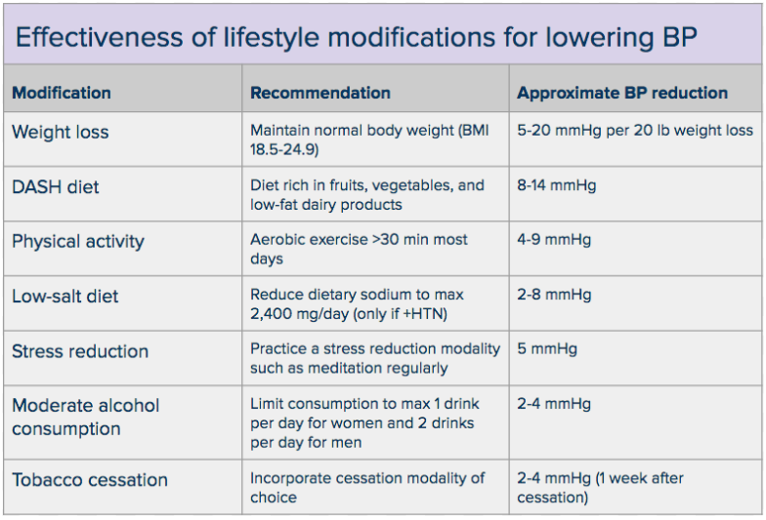

Slide 22
Pharmaceutical approach: JNC 8 or ACC/AHA First line: monotherapy
Regardless of the guidelines avoid starting an older patient on two antihypertensive drug at the same time.
Patient with no specific clinical reason/comorbidities
4 main class of drugs
Thiazide diuretics (chlorthalidone preferred)
Dihydropyridine Calcium channel Blockers (Example: Norvasc: Vasodilators, with minimal inotropic effect: No decrease heart rate)
ACE inhibitors
ARB if can’t use ACE
Monotherapy based upon age and race
FYI patient <50 yo: Ace inhibitor or ARB,
Patient > 60 yo: Thiazide or dihydropyridine CCBs.
Black patients any age: Thiazide or dihydropyridine CCBs

Slide 23
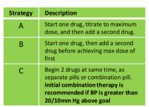
Sequential Drug therapy if does not respond to monotherapy
Please do not follow strategy A. Too many issue and not beneficial in the long run, Usually followed for patient max on all drugs (resistant to all drugs.) So keep away.
For older patient: Follow strategy B.
For instance: patient not at goal and compliant with Norvasc 10 mg daily, do not increase to 20 mg daily, instead you can add thiazide 12.5 mg daily.
For patient less than 50 yo or if robust less than 60 yo you may follow strategy C.
Avoid Strategy C for patient older than 60 yo.

Slide 24
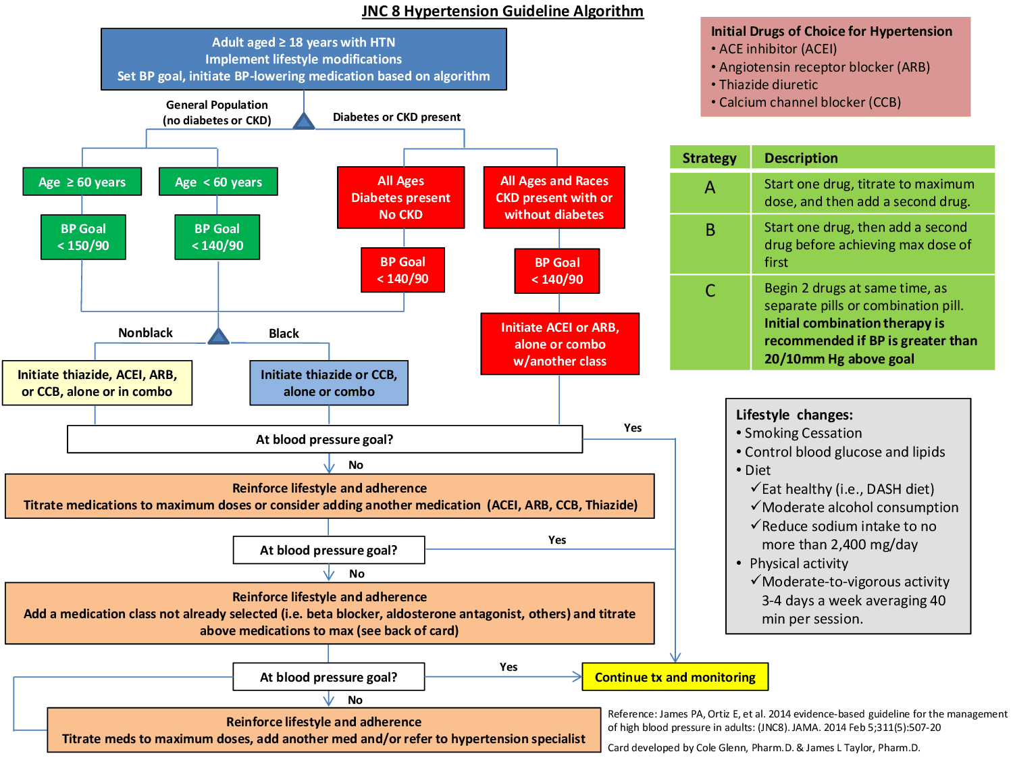

Slide 25
According to the ACC/AHA:
The decision to initiate drug therapy should be individualized and involve shared decision-making between patient and provider. (CHART chart chart)
Patient with a diagnosed of HTN without comorbidities
Patients with out-of-office daytime blood pressure ≥135 mmHg systolic or ≥85 mmHg diastolic
And/or an average office blood pressure ≥140 mmHg systolic or ≥90 mmHg diastolic
Patient with a diagnosed of HTN with comorbidities
Patients with an out-of-office or in-office blood pressure (mean home or daytime ambulatory) ≥130 mmHg systolic or ≥80 mmHg diastolic and the following comorbidities
Established clinical cardiovascular disease (eg, chronic coronary syndrome [stable ischemic heart disease], heart failure, carotid disease, previous stroke, or peripheral arterial disease)
Type 2 diabetes mellitus
Chronic kidney disease
Age 65 years or older
An estimated 10-year risk of atherosclerotic cardiovascular disease of at least 10 percent

Slide 26
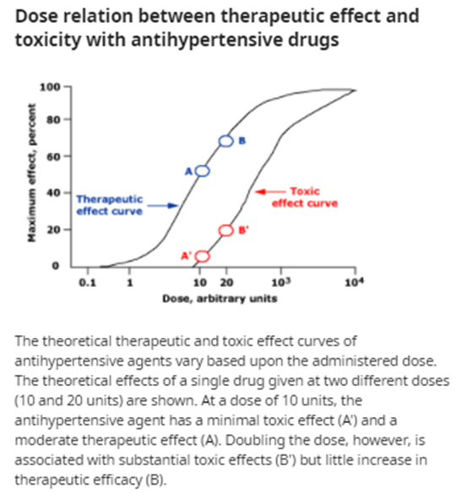
Titration for older patients
Patient specific: Guidelines differ from one organization to the other
Reasonable approach for older patients:
After monotherapy has been initiated, assess in 4 to 6 weeks
If inadequate response titrate up to mid range of the medication (ex: HCTZ 12.5 to 25 mg) then reassess in 4 to 6 weeks
Limit titration to one step with a given drug. Never max a drug (strategy B)
If one step titration fails, you can do the following:
Switch to a different more potent antihypertensive agent.
Divide current dose to twice daily (for instance instead of Norvasc 1o mg daily-> Norvasc 5 mg twice daily)
Not always the best: issue with compliance.
Add a second medications (lower end for instance for a older patient add Norvasc 5 mg daily to HTCZ 25 mg daily) and assess in 4 to 6 weeks.
If they can afford it and available, prescribe a combo med
Add a second med (dose specific to patient’s B/p and tolerance: if less than b/p 20/10 : lowest dose, higher dose if above and can tolerate it)

Slide 27
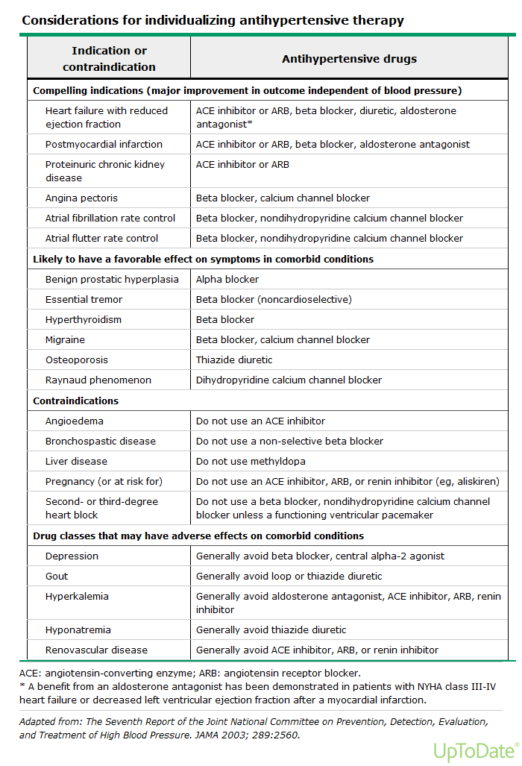

Slide 28
Contraindications
▪ Diuretics may worsen gout.
Avoid thiazide and loop diuretic in patient with sulfa allergy – Cross sensitivity
▪ β-Blockers (relative) in reactive airway disease, heart block, diabetes, and peripheral vascular disease; probably should be avoided in patients with metabolic syndrome or insulin-requiring diabetes.
β-Blockers : Wean slowly after chronic use.
Diltiazem or verapamil: Do not use with systolic dysfunction or heart block.
Amlodipine may cause peripheral edema and GERD.
CCB: don’t prescribe to patients with heart block without a pacemaker.

Slide 29
Key Clinical Points
The prevalence of hypertension increases steadily with age.
Older people develop systolic hypertension due to the age-related increase in arterial stiffness. Systolic blood pressure and pulse pressure, both closely associated with arterial stiffness, confer the greatest significance as cardiovascular and cerebrovascular risk factors.
Age-related changes in systems that regulate blood pressure result in greater blood pressure variability. Therefore, careful attention is needed to accurately measure and diagnose hypertension, as well as monitoring for adverse drug events—especially postural hypotension—throughout treatment.
Older hypertensive individuals commonly have physiologic characteristics that respond effectively to lifestyle modifications.

Slide 30
Hypertension.
Follow-up
Frequency based on level of hypertension:
Prehypertensive: 3 to 6 months
If systolic and/or diastolic B/P less than 20 mmHg from target four to 6 weeks
If systolic and/or diastolic B/P more than 20 mmHg from target within two to 4 weeks.
Best practice: one month to bring B/P to target. Usually not possible for the elderly as you have to go slow and start low.
Repeat electrolytes, BUN/creatinine about 3 to 6 weeks after initiating thiazide diuretics, ARB, or ACEi, to evaluate for drug-induced complications
When patient is stable: OK to follow up q 6 to 12 months.

Slide 31
Hypertension
Prevention/prophylaxis
Lifestyle modification
Routine BP monitoring: Home self b/p.
Monitor quality of life ( address dizziness, fatigue, sexual function, fall)
Referral
Unusual signs and symptoms
Suspected secondary cause
Education
Routine BP monitoring
Proper BP measurement technique
Encourage compliance

Slide 32
Atrial fibrillation (Afib)
Afib: paroxysmal or continuous supraventricular tachyarrhythmia characterized by rapid, uncoordinated atrial electrical activity and an irregularly irregular ventricular response. In most patients

Slide 33
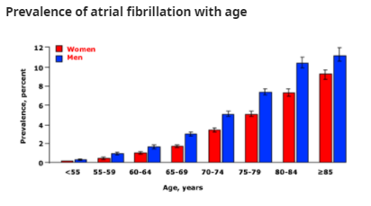
Tachyarrhythmias – Atrial fibrillation- updated 2022
The most common sustained arrhythmia seen in clinical practice
Incidence and prevalence increase exponentially with age, such that the prevalence in octogenarians is approximately 10%
Patients over age 80 account for approximately 35 percent of patients with AF and the prevalence of AF is about 10 percent
rate control has often been preferred in the elderly patients for the following reasons:
They are more sensitive to the proarrhythmic effects of drugs
AF is often permanent
AF is often asymptomatic

Slide 34
Types of Atrial fibrillation
Paroxysmal: Episodes last < 7 days vast majority less than 24 hours. Respond to cardioversion
Persistent: Last > 7 days, respond to cardioversion but may occur again
Permanent: Present > 1 year, usually failed cardioversion
Valvular Afib vs Nonvalvular Afib
Valvular Afib: affects people who have moderate to severe valve diseases only or an artificial valve.
NonValvular AFIB: atrial fibrillation that isn't caused by a problem with a heart valve

Slide 35
Risk and contributing factors:
Most common Risk factors:
Age
HTN,
Obesity
Other risk factors
Male sex
European ancestry (Caucasians)
Diabetes
Most are idiopathic.
Coronary artery disease
Heart failure
Cardiomyopathy (ischemic or nonischemic)
Valvular diseases (e.g., mitral regurgitation, mitral stenosis)
Hyperthyroidism
Cardiac procedures or surgeries
Alcohol abuse
Sleep apnea
COPD
Serious infections (e.g., pneumonia)

Slide 36
AF: CLINICAL FEATURES
Symptoms related to AF are highly variable
Often asymptomatic specially if ventricular response is 60 to 100 beat per minute
Most common: palpitations, shortness of breath, impaired exercise tolerance, dizziness, presyncope or syncope, fatigue, anxiety, chest pressure.
Physical exam:
Irregularly irregular heart rate and pulse with pulse deficit

Slide 37
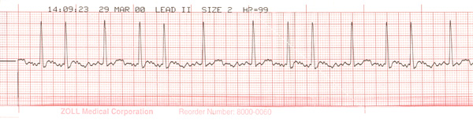
Diagnostics (Class)
History and physical:
In patients with ongoing AF, the standard 12-lead electrocardiogram is diagnostic
Absence p wave, irregular QRS interval, and usually tachycardia
Ambulatory rhythm monitoring (Holter monitoring) is helpful in diagnosing paroxysmal AFib or AFlut and monitoring for recurrence
Initial Lab studies:
CBC, CMP, thyroid function, renal functions, Toxicology screen (if you suspect drug use), D-dimer, BNP (r/o HF),
PT/INR if you contemplate anticoagulation.
troponin if suspect unstable angina or MI. (if you feel you need this, transfer to ER)
If patient is on digoxin, order a level.

Slide 38
Follow-up tests
Exercise stress test
Holter monitor
Chest x-ray (CXR) for cardiopulmonary disease
Echocardiogram
TEE (Transesophageal echocardiogram) to detect left atrial appendage thrombus if cardioversion is planned
Sleep study may be useful if sleep apnea is suspected.

Slide 39
MANAGEMENT OF AF
Decision making:
Heart rate versus rhythm control.
Anticoagulate or not.
Behavioral modifications:
Avoid stimulant (caffeine, nicotine, decongestant) and ETOH above recommended guidelines
Encourage physical activities and weight reduction

Slide 40
MANAGEMENT OF AF
Identify and treat the underlying cause(s), such as:
Treat the hyperthyroidism.
Treat the hypertension.
Manage electrolyte unbalance
Principal strategies for relieving symptoms: control of heart rate and/or maintenance of normal sinus rhythm
80 to 100 beats/min at rest
90 to 110 beats/minutes minute with moderate exercise

Slide 41
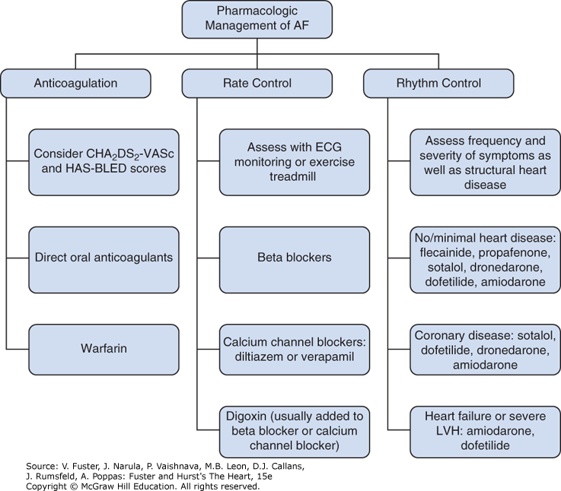

Pharmacologic management of AF. The three pillars of management of AF are anticoagulation, rate control, and rhythm control. The decision on anticoagulation is based on the CHA₂DS₂-VASc and HAS-BLED scores. Direct oral anticoagulants are preferred over warfarin except in specific situations, such as the presence of a mechanical heart valve. Rate control is best accomplished with β-blockers or calcium channel blockers, with digoxin added in selected cases when rate control is not adequate. Rate control should be assessed with 24-hour ambulatory monitoring, and in some cases, exercise treadmill testing. The choice of an antiarrhythmic drug is based on the presence or absence of underlying heart disease. Flecainide and propafenone may only be used in patients without structural heart disease. Amiodarone is a second-line agent in patients with no or minimal heart disease, whereas it is a first-line agent in patients with HF and severe LV hypertrophy.
Citation: Chapter 36 Atrial Fibrillation and Atrial Flutter, Fuster V, Narula J, Vaishnava P, Leon MB, Callans DJ, Rumsfeld J, Poppas A. Fuster and Hurst's The Heart, 15e; 2022. Available at: https://accessmedicine.mhmedical.com/content.aspx?bookid=3134&sectionid=265676221 Accessed: July 05, 2022
Copyright © 2022 McGraw-Hill Education. All rights reserved

Slide 42
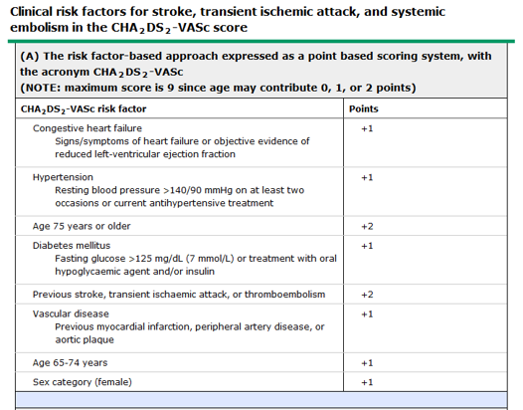
MANAGEMENT OF AF: STROKE RISK STRATIFICATION

Slide 43
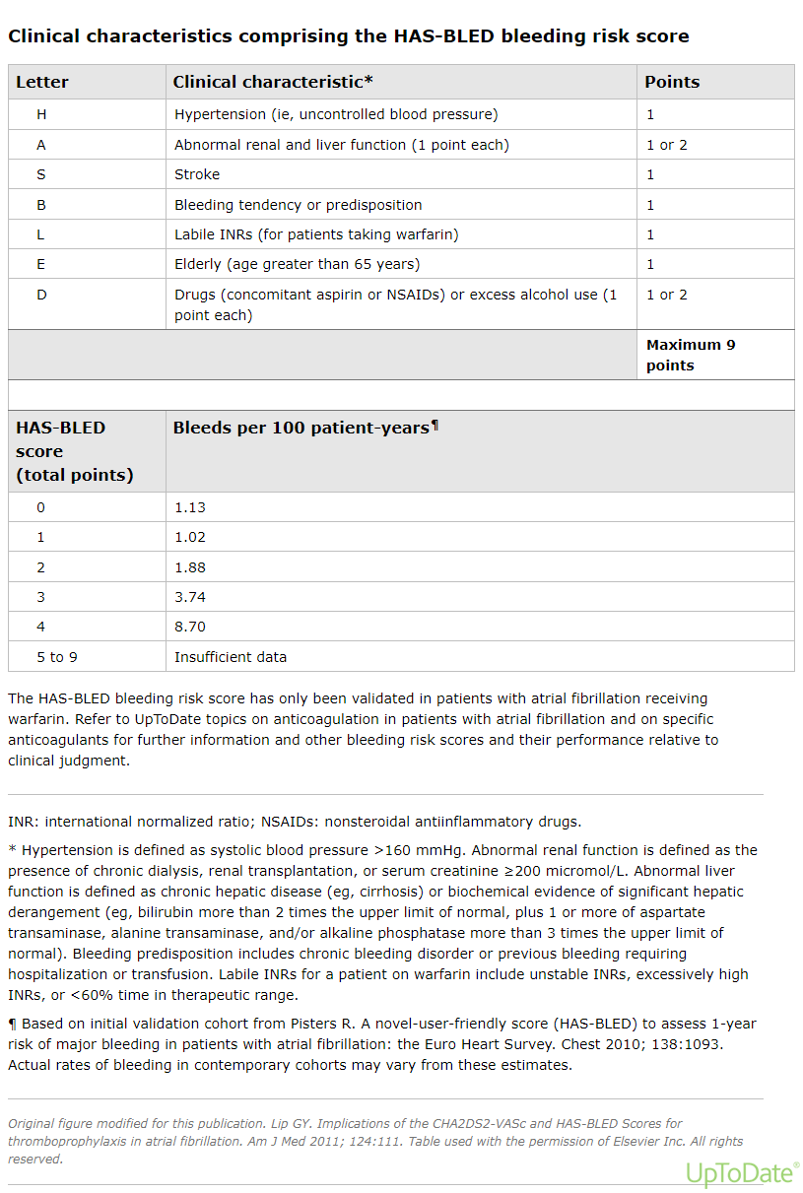
a score of 0 indicates low risk
1–2 indicates moderate risk
and ≥3 indicates high risk.
Please note: Decision to anticoagulate patient or not
should not be based solely on the has-bled score
Your goal is to deal with modifiable risk factors and decrease the has-bled score
1- Control HTN
2- D/c NSAIDS or aspirin
3- ETOH management
4- If on warfarin. Tighter control with more frequent monitoring and
diet management or switch them to a NOAC
5- preserve kidney and liver function: Pharm and non pharm approach.
Only two nonmodifiable risk factors are age, bleeding predisposition (ITP)
or stroke.
Recommendations: Management with anticoagulants
Benefits outweigh the risk of bleeding in following group regardless of the
has-bled score.
For a CHA₂DS₂-VASc score ≥2 in males or ≥3 in females
For a CHA₂DS₂-VASc score of 1 in males and 2 in females based
on age 65 to 74 years,. Age 65 to 74 years is a stronger risk factor
than the other factors conferring one CHA₂DS₂-VASc score point

Slide 44
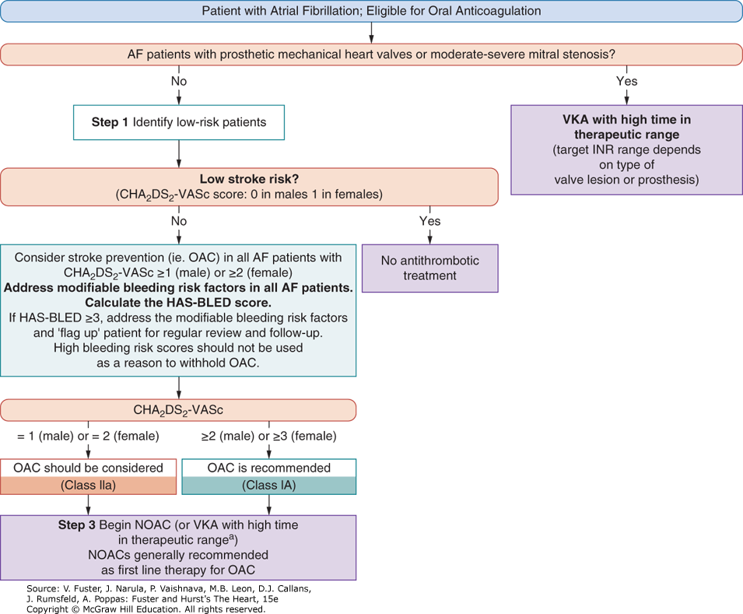
Two groups of oral anticoagulant drugs are used, vitamin K antagonists VKA (warfarin/Coumadin) and non–vitamin K antagonist oral anticoagulants (NOACs).
Decision pathway for anticoagulation use in patients with AF. Key: AF, atrial fibrillation; CHA2DS2-VASc, Congestive heart failure, Hypertension, Age >_75 years, Diabetes mellitus, Stroke, Vascular disease, Age 65–74 years, Sex category (female); HAS-BLED, Hypertension, Abnormal renal/liver function, Stroke, Bleeding history or predisposition, Labile INR, Elderly (>65 years), Drugs/alcohol concomitantly; INR, international normalized ratio; NOAC, non–vitamin K antagonist oral anticoagulant; OAC, oral anticoagulant; SAMe-TT2R2, Sex (female), Age (<60 years), Medical history, Treatment (interacting drug(s)), Tobacco use, Race (non-Caucasian) (score); TTR, time in therapeutic range; VKA, vitamin K antagonist. If a VKA is being considered, calculate SAMe-TT2R2 score: if score 0–2, may consider VKA treatment (eg, warfarin) or NOAC; if score >2, should arrange regular review/frequent INR checks/counselling for VKA users to help good anticoagulation control, or reconsider the use of NOAC instead; TTR ideally >70

Slide 45
MANAGEMENT OF AF: STROKE PROPHYLAXIS
DOAC (direct-acting oral anticoagulant)/NOAC (novel oral anticoagulant) agents are preferred for most patients with nonvalvular atrial fibrillation who should receive anticoagulant therapy Dabigatran 150 mg q12h when creatinine clearance (CrCl) ≥ 50 mL/min (75 mg q12h when CrCl = 15–30 mL/min). No INR monitoring needed
Rivaroxaban (Xarelto) 20 mg/d when CrCl ≥50 mL/min (15 mg/d when CrCl = 15–50 mL/min)
Apixamab (Eliquis) 5 mg twice daily (2.5 mg twice daily when 2 or more of the following are present: age ≥80 years, weight ≤60 kg, or creatinine ≥1.5 mg/dL)
Edoxaban (savaysa) 60 mg po daily
Warfarin
Patients with mechanical valves should be treated with warfarin to maintain an INR of 2.0 to 3.0 or 2.5 to 3.5 dependent on the type and location of the prosthesis.
titrated to maintain an INR of 2–3
Initial dose Coumadin 5 mg for adults, but start at 2.5 mg elderly patient older than 70 yo
Check INR q 2-3 days until therapeutic for two consecutive checks, then recheck in a week if therapeutic check once monthly.

Slide 46
Rhythm control versus rate control in atrial fibrillation
Both strategies can fail both in the short and in the long terms.
Most patient with new onset AFIB spontaneously convert within 72 hours after start of rate control medication.
If they do not spontaneously convert. At least one attempt at cardioversion should be attempted.
Cardioversion is most often performed electrically but may also be achieved using antiarrhythmic drug therapy in some instances, by experienced clinicians. (not in primary care)
If duration of AFib/AFlut is ≥48 hours or unknown, anticoagulated for ≥3 weeks before cardioversion to reduce the risk of stroke.
Cardioversion attempted only after TEE is performed, continue anticoagulation 4 weeks post cardioversion.
Hemodynamically unstable: Hospitalization: Rhythm control is favored. Chemically or via cardioversion. See above.

Slide 47
Pharmacology intervention Rate control in stable patients: Go Slow start low
Optimal target for ventricular rate has not been firmly established, but there is evidence that aggressive control of the ventricular rate (<80 bpm) offers no benefit beyond more modest rate control (i.e., resting heart rate <110 bpm). So a range between range 80 to 100 is acceptable at rest
1- Beta blockers (e.g., metoprolol tartrate [Lopressor], atenolol [Tenormin])
Example: metoprolol tartrate at 12.5–100 mg PO BID.
Use in those with CAD and/or reduced systolic function.
2- Nondihydropyridine calcium channel blockers (e.g., verapamil [Calan, Verelan], diltiazem [Cardizem])
Example: diltiazem (immediate release) 60–120 mg PO TID (max: 360 mg/day).
Avoid use in those with reduced systolic function.
Avoid combo therapy with a beta blocker increases bradycardia, syncope, and hemodynamic instability.
3- Digoxin (least effective) for sedentary older adult only (80-year-old and above)
Example: digoxin 125 mcg PO daily.
Can be taken with a beta blocker or calcium channel blocker.
4- Amiodorone: (considered mostly a rhythm control meds, but it does slow down ventricular rate)
Due to short- and long-term effects: AHA/ACC strongly recommends to only as a second line therapy if other meds fail

Slide 48
A-FIB: Rhythms control
Restoration of sinus rhythm using electrical or pharmacologic cardioversion – Patient must be hemodynamically stable
Electrical: Cardioversion
without anticoagulant therapy if Afib started less than or equal to 48 hours
If duration of AFib is >48 hours or unknown, anticoagulate for ≥3 weeks before cardioversion to reduce the risk of stroke.
Usually cardiologist will perform a TEE to r/o atrial thrombus
Continue anticoagulation for at least 4 weeks post successful cardioversion
The 2014 American College of Cardiology (ACC)/American Heart Association (AHA)/Heart Rhythm Society

Slide 49
A-FIB: Rhythm control strategies.
Involve a cardiologist:
Preferred for patients:
at high risk for a CV event
Fail rate control
AF diagnosed within one year who have not spontaneously converted
hemodynamically instable patients
Younger patient less than 60 yo or who are extremely active and need optimal cardiac performance.
Restoration of sinus rhythms can be achieved with cardioversion: electrically or with antiarrhythmic drug therapy, ablation can also be performed as a last resort.
Antiarrhythmic therapy for long-term maintenance of sinus rhythm:
Options for pharmacologic cardioversion include Flecainide, dofetilide, propafenone, ibutilide and amiodorone if LVH, HF, or CAD. Amiodarone is effective and is commonly prescribed.(and a horrible drug)
There is currently no standard/optimal rhythm control drug therapy in older adults with symptomatic AF

Slide 50
ISSUES FOR REFERRAL
Management of AFib refractory to standard medical therapy
unable to achieve adequate rate control with medication
development of significant bradycardia and hemodynamic instability with rate control
the use of more aggressive treatments.
These may include pacemaker implantation
to allow for more intensive pharmacologic blocking of the AV node
or an ablation procedure. AFlut in particular is often very amenable to ablation;
thus, consideration should be given to early expert referral in appropriate patients. Antiarrhythmic drug therapy can often be very effective but should be prescribed by experienced practitioners.

Slide 51
Ongoing care
FOLLOW-UP RECOMMENDATIONS
Patient Monitoring
Adequate anticoagulation levels with warfarin should be determined weekly during initiation and monthly when stable. If NOACs are employed, hepatic and renal functions should be reevaluated annually
DIET
Patients on warfarin should attempt to consume a stable amount of vitamin K.
PATIENT EDUCATION
For overweight and high BMI patients, weight loss combined with risk factor modification have demonstrated beneficial effects on controlling AFib

Slide 52
Heart Failure- Updated guidelines 2022
Signal symptoms
Dyspnea on exertion, orthopnea, fatigue, leg edema, paroxysmal nocturnal dyspnea, progressive activity intolerance,
Description
Pump failure: Clinical syndrome caused by the heart’s inability to eject enough blood to maintain tissue perfusion
Different types:
Right vs left Heart failure
Heart failure with reduced ejection fraction (HFrEF) AKA systolic heart failure
Heart failure with preserved ejection fraction (HFpEF). AKA diastolic heart failure

Slide 53
PROGNOSIS
Median survival rates of 2–3 years
25%–30% of patients die within 1 year after initial diagnosis
50% survive 1–5 years
20%–25% survive >5 years
More than 250 thousands Americans die from HF each year.
patients with HFPEF (Diastolic heart failure) have somewhat better survival rates than patients with systolic HF (HFREF= EF less than 40%)

Slide 54
EPIDEMIOLOGY OF HEART FAILURE (HF)
Incidence and prevalence increase with age
6 millions Americans and >850,000 new cases annually
Leading cause of hospitalization and rehospitalization in older adults
Median age of patients hospitalized with HF is 75 years, and approximately two thirds of deaths attributable to HF are in patients age 75 years or older
HF is a major cause of chronic disability and impaired quality of life in older adults

Slide 55
Risk factors
older age
Higher in AA with poorer outcomes
physical inactivity
cigarette smoking
lipid abnormalities
overweight/obesity
Hypertension: (lead to structural and functional abnormalities-> increase mortality. Controlling B/p is primordial especially in HFpEF.
diabetes mellitus
metabolic syndrome
Insulin resistance
Outcomes and progression of disease
Worst among patients with diabetes and/or insulin resistance and/or lipid abnormalities.
High B/p and elevated BMI are associated with better outcomes in HF patients.

Slide 56
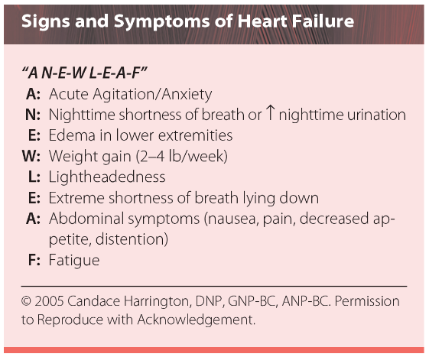
Heart Failure
Cardinal S/S of HF
Dyspnea
fatigue
decrease exercise tolerance
fluid retention
S/s of pulmonary and/or splanchnic congestion
and/or peripheral edema.

Slide 57
Clinical approach: In primary care
probability of HF if patient presents with symptoms or signs of HF:
based on the patient’s prior clinical history, presenting symptoms, physical examination, and resting electrocardiogram.
If these elements are normal, HF is unlikely, and other diagnoses should be considered.
If at least one of these elements is abnormal, plasma NPs should be measured, if abnormal order an echocardiography.
American College of Cardiology/American Heart Association (ACC/AHA) guidelines recommend that when patients present with dyspnea, measurement of BNP or NT-proBNP can be useful to support a diagnosis and severity or to exclude HF.

Slide 58
Recognizing worsening HF
Clinical clues that a patient may have worsening or advanced HF include the folllowing:
Persistent New York Heart Association (NYHA) III-IV symptoms
≥2 emergency department (ED) visits or hospitalizations for acute HF in 12 months
High risk biomarker profile (hyponatremia, very elevated NPs or troponin)
Inability to up titrate guideline-directed medical therapies because of hypotension (SBP ≤90 mmHg), dizziness, excessive fatigue, nausea, etc.
Onset of arrhythmias (atrial fibrillation, ventricular tachycardia with implantable cardioverter-defibrillator [ICD] shocks)
Escalating doses of diuretics (e.g., >160 mg/d furosemide) or persistent edema despite escalating diuretic doses
Need for intravenous inotropes

Slide 59
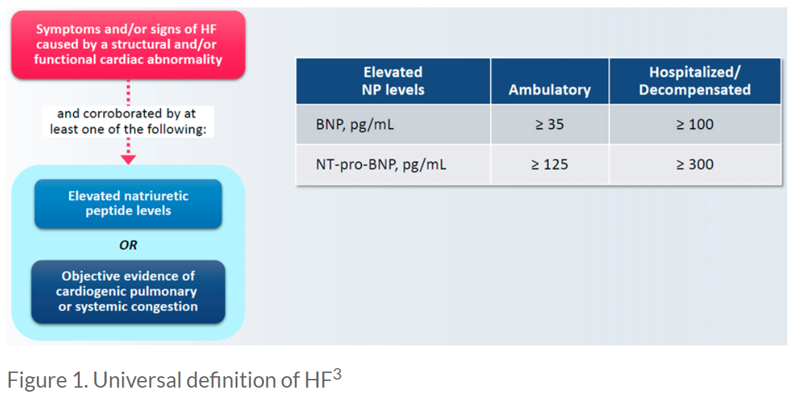
Heart Failure: Revised guidelines 2022

Slide 60
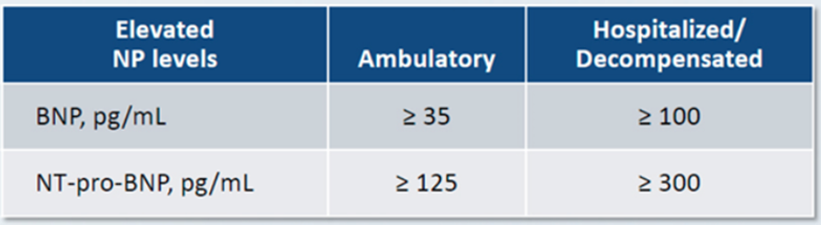
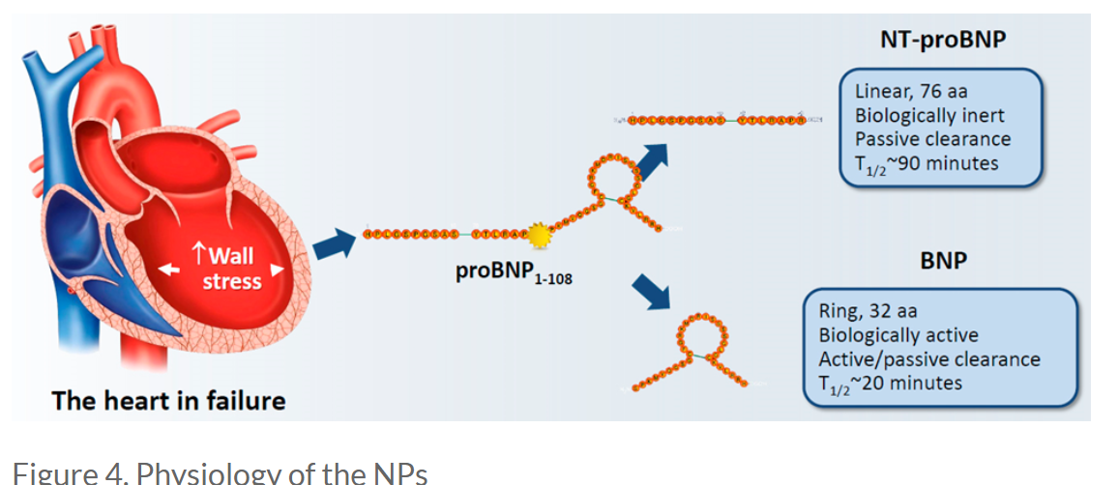
Biomarkers in HF
Early diagnosis of HF is challenging
Nonspecific clinical presentation of HF
Use of biomarker: BNP, NT pro-BNP: essential in patient’s evaluation and diagnostic process.
Note: patients with HFpEF (more than 50%) ,
AA and high BMI may have low BNP baseline
cardiac troponin is not specific for establishing a diagnosis of HF.
Elevated high-sensitivity cardiac troponin (hs-cTn) is associated with worse clinical outcomes.

Slide 61
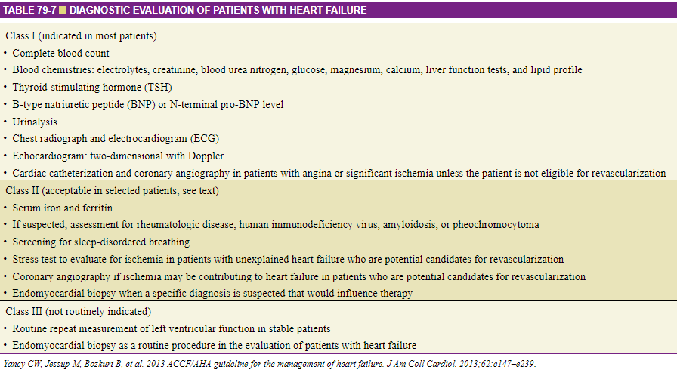
American College of Cardiology and American Heart Association revised guidelines for the diagnosis of Health failure

Slide 62
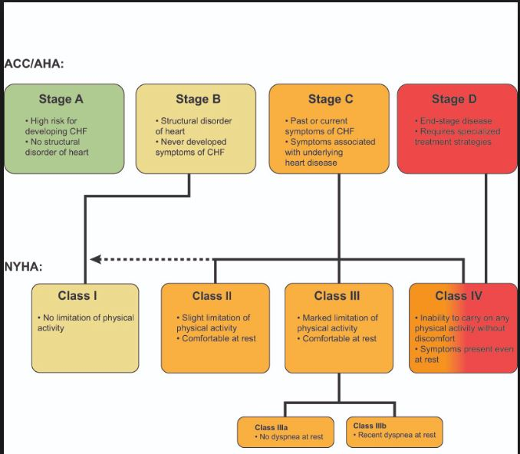
Classification of heart failure:ACC/AHA objective stages vs NYHA functional capacity class

Slide 63
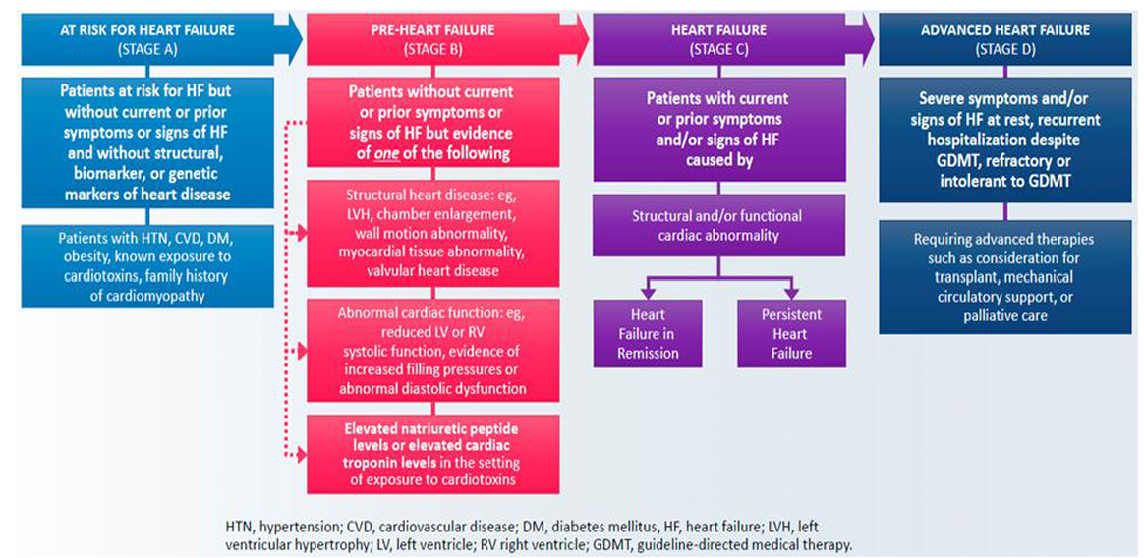
New classification of Heart failure stages

Slide 64
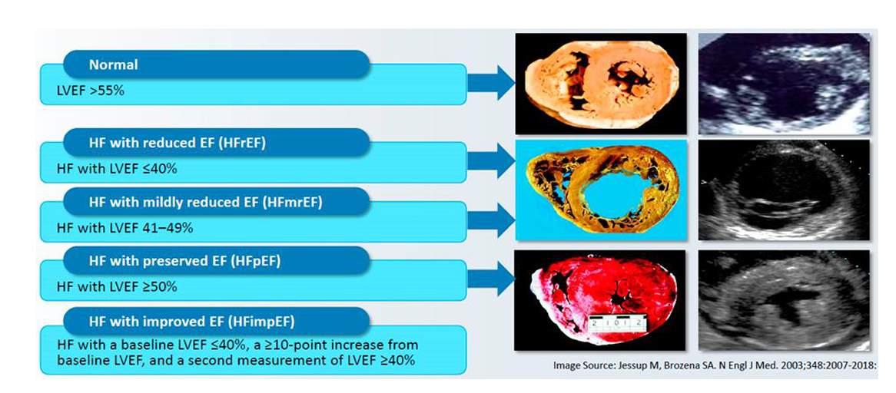
Classification according to left ventricular ejection fraction

Slide 65
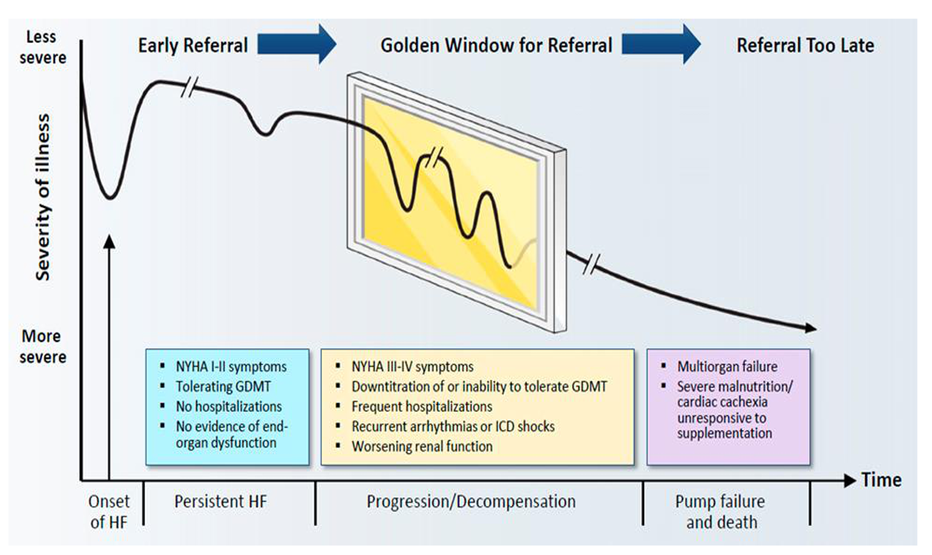
Golden window for referral for consideration of advanced HF therapies

Slide 66
HF management approach: Goals
Improving survival and reducing morbidity
Improving functional capacity and quality of life (QoL).
Controlling modifiable Risk factors for HF:
Physical conditioning by exercise training can improve exercise tolerance, health-related QoL, and HF hospitalization rates in patients with HF.
A shared decision-making approach is recommended

Slide 67
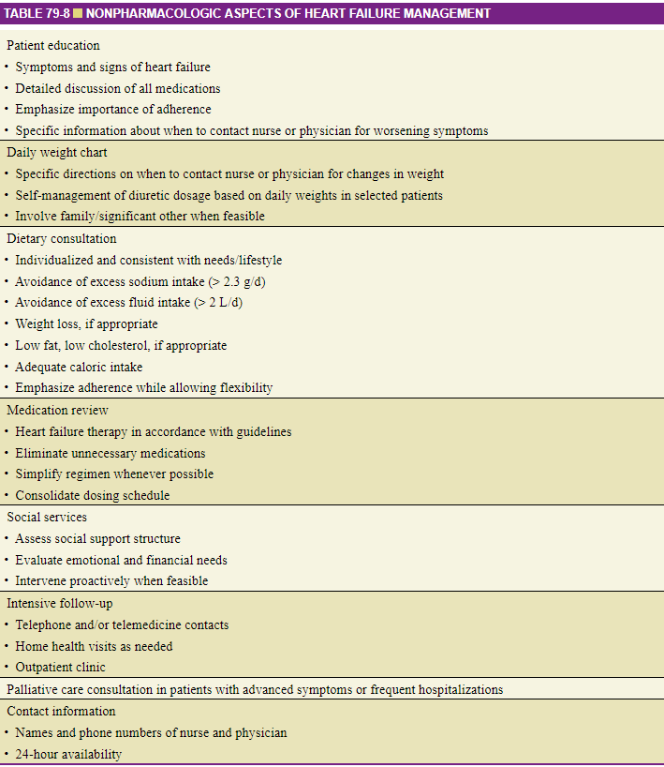

Slide 68
Management of HFrEF
targeting the RAAS is a cornerstone of the medical management of HFrEF.
inhibition of the RAAS with
angiotensin receptor-neprilysin inhibitor (ARNI)
Or angiotensin converting enzyme (ACE) inhibitors,
Or angiotensin receptor blockers (ARBs),
ARNI is now the preferred RAAS inhibitor for HFrEF. (reimbursed by insurance)
mineralocorticoid receptor antagonists (MRA)
in conjunction with evidence-based β-blockers (carvedilol, bisoprolol, metoprolol succinate).
SGLT2 inhibitor
Mechanisms of drug actions:
ACE, ARB and ARNI: inhibit conversion of angiotensin I to angiotensin II, which prevents vasoconstriction and induces relaxation of the vasculature-> decreasing cardiac workload.
MRAs slow HF progression, prevent/reverse cardiac remodeling, and prevent the development of arrhythmias by blocking aldosterone,
β-blockers prevents the ventricular remodeling
SGLT2 inhibitor: (see following slide)

Slide 69
HFrEF/Systolic Heart failure Reduced EF less or equal 40-50 %.
Chronic treatment
TARGETING THE RASS first: IT is the cornerstone of the management of HF
ARNI is preferred approach above ace or arb (use ot be extremely expensive now it is covered by medicare)
Initial: Sacubitril 49 mg/valsartan 51 mg twice daily. Double the dose as tolerated after approximately 2 weeks to the target maintenance dose
ACE inhibitors (ACEIs) or ARB if can tolerate ACEIs. But never both together or in addition with an ARNI
Ace inhibitor for instance:
Enalapril: Initial: 2.5 mg twice daily; as tolerated, may increase dose (eg, double) every ≥2 weeks to a target dose of 10 to 20 mg twice dailyFirst-line therapy in individuals with systolic dysfunction. They prevent left ventricular remodeling. The significance of ACEIs and ARBs in those with diastolic heart failure is uncertain.
Use an ARB, such as valsartan (Diovan) 20–40 mg PO BID (max: 320 mg/day), if unable to tolerate an ACEI due to side effect, such as cough.
Monitor for cough (excluding ARBs), renal impairment, angioedema (rare with ARBs), and hyperpotassemia.
Beta blockers
Example: Start carvedilol at 3.125 mg BID (max: 50 mg/day).
Monitor closely for bradycardia, hypotension, and fatigue
SGLT2 I: two approved for HF: Dapagliflozin (Farxiga) 10 mg once daily or Empagliflozin (Jardiance) Oral: 10 mg once dailyDiuretics
mineralocorticoid receptor antagonist (e.g., spironolactone [Aldactone]).
Can be added at any time.
Example: Start spironolactone at 12.5–50 mg PO QD.
Monitor renal function and electrolytes closely.
.

Slide 70
ACE inhibitors, ARBs, and ARNIs
with HFrEF, treatment with sacubitril-valsartan was superior to enalapril in reducing the risk of death and hospitalization due to HF.
ACE is superior to ARB.
In patients with chronic symptomatic HFrEF NYHA class II or III who tolerate an ACE inhibitor or ARB, replacement with an ARNI is recommended to further reduce morbidity and mortality.
An ARNI should not be administered concomitantly or within 36 hours of the last dose of an ACE inhibitor, and it should also not be administered to patients with a history of angioedema.

Slide 71
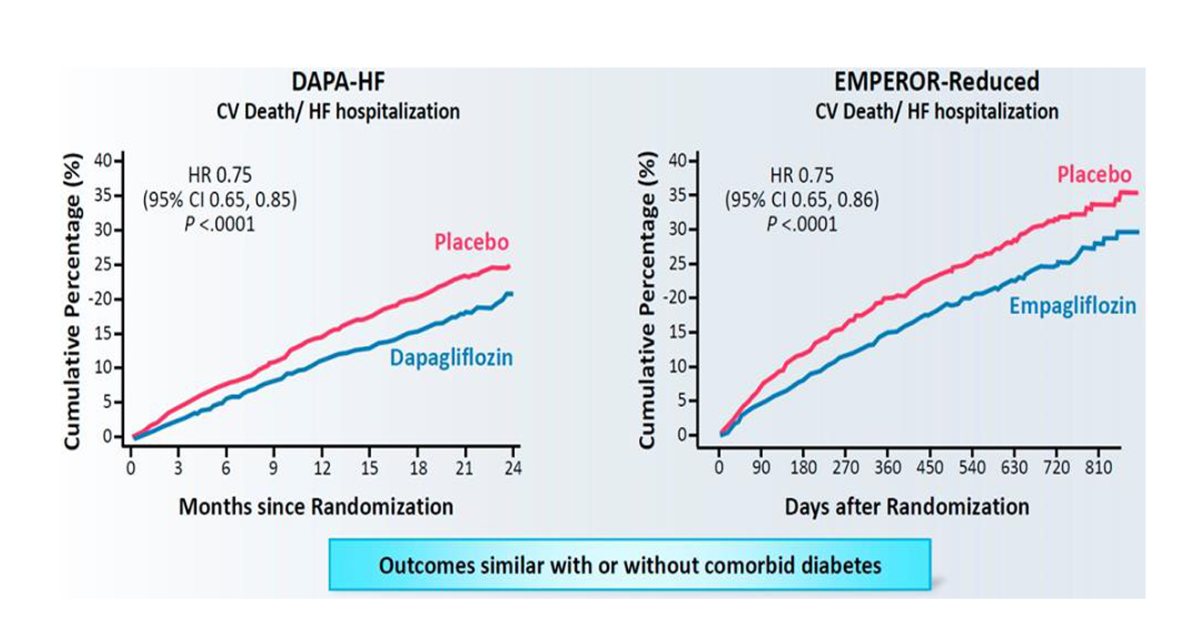
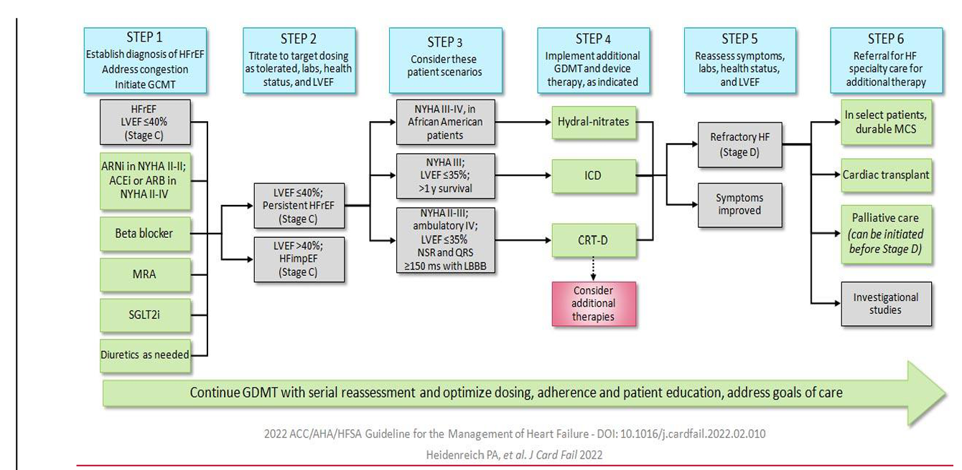
SGLT2 inhibitors
Dapagliflozin is approved for adults with NYHA class II-IV HFrEF, with or without type 2 diabetes mellitus (T2DM), to decrease the risk of hospitalization for HF and cardiovascular death. Empagliflozin was recently approved to reduce the risk of cardiovascular death and HF hospitalization in adults with HF
Primary care: Step 1 and 2 only. Referral might be needed at step one, depending on the provider but definitely at step 4
GDMT: Guideline‐Directed Medical Therapy

Slide 72
STEP 1: Management of HFrEF
medications may be started simultaneously at initial (low) doses recommended for HFrEF even for elderly.
Or these medications may be started sequentially for frailed patient, with sequence guided by clinical or other factors, without need to achieve target dosing before initiating next medication.
Might be preferred for the elderly. Start with ARNI low dose, then add Beta blocker ASAP, MRA, then SGLT2 inhibitors. Titrate up as tolerated and depending on the clinical presentations and comorbidities.
Medication doses should be increased to target as tolerated.

Slide 73
Other new treatment for management of HFrEF
Vericiguat
The 2022 AHA/ACC/HSFA guideline recommends that in selected high-risk patients with HFrEF and recent worsening of HF already on GDMT, an oral sGC stimulator (vericiguat) may be considered to reduce HF hospitalization and cardiovascular death
This is beyond step 2 management: Cardiologist should be starting this medication

Slide 74

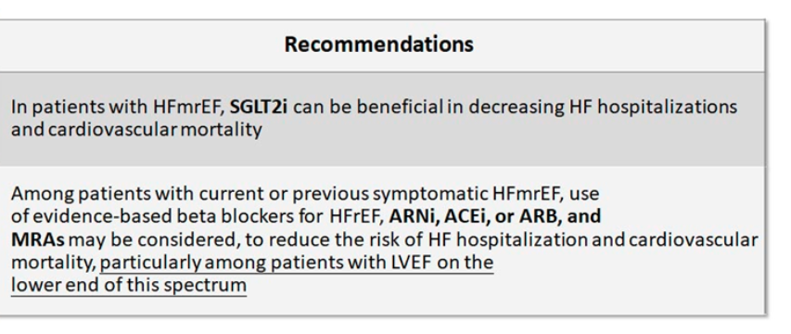
Management for HFmEF

Slide 75
HFpEF/Diastolic Heart failure Preserved EF more than 50%.
In diastolic HF: SGLT2, ACEIs or ARBs (ARBs > ACE1s) ARNI and MRA(spironolactone) can be used to potentially reduce hospitalizations and mortality
Best approach: Continue to be the management of associated symptoms (HTN…)
Treatment of HFpEF is largely governed by management of associated conditions and symptoms: hypertension, lung disease, coronary artery disease, atrial fibrillation (AF), obesity, anemia, diabetes mellitus, kidney disease, and sleep disordered breathing
Goal: Improved ventricular relaxation, decrease heart rate, maintain sinus rhythm and treat HTN to avoid LV remodeling and exacerbation.

Slide 76
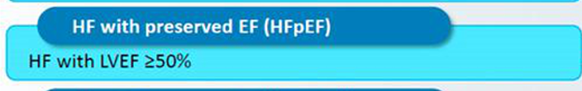
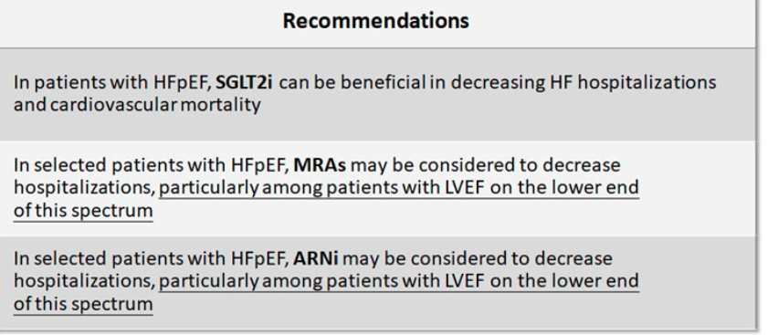
Management of HFpEF

Slide 77
Summary
medical therapies for the treatment of HFrEF and HFpEF is rapidly evolving
The four pillars – ARNI + beta-blocker + MRA + SGLT2 inhibitor – are considered the new “standard of care” for HFrEF
ARNIs and SGLT2 inhibitors have benefits in HF across the spectrum of EF, including in those with HFmrEF and select patients with HFpEF
Morbidity, mortality, and hospitalizations can be reduced by attention to a multidisciplinary, comprehensive disease management program.

Slide 78
Coronary Artery disease (Taped)
Prevalence:
6% of American older than 75 years of age and account for 60% CAD-
Leading cause of death in elderly
Age, gender, ethnicity factors
Markedly increased prevalence with age
Greater incidence in men

Slide 79
Coronary Artery Disease
Description
Imbalance between the supply and demand for blood flow to the myocardium
Etiology
Most often cause by atherosclerosis
Imbalance between myocardial demand and coronary perfusion

Slide 80
CAD Manifestation
Early: asymptomatic
Stable angina: Predictable discomfort related to exertion (physical or emotional)
Acute Coronary syndrome
Unstable angina: Unpredictable symptomatology, often at night. EKG changes but no enzymes abnormality (Troponin, CPK)
NSTEMI
STEMI
Both NSTEMI and STEMI with EKG changes and enzymes elevations.

Slide 81
CAD
Epidemiology:
CAD is the leading cause of death for adults both in the United States and worldwide.
The cost of CAD in the United States was $555 billion in 2016 and is expected to rise to $1.1 trillion by 2035.
~80% of CAD is preventable with a healthy lifestyle.
Incidence
In the United States, the lifetime risk of a 40-year-old developing CAD is 49% for men and 32% for women.
Prevalence
In the United States, 28.4 million people carry a diagnosis of CAD, whereas 7.12 million have angina pectoris.
.

Slide 82
CAD signal symptoms
Signal symptoms
Substernal Chest pain, tightness, or discomfort frequently radiate to jaw, back or arms last 2 minutes to 15 with stable or unstable angina or constant with STEMI NSTEMI and sometimes unstable angina.
Atypical symptoms in the elderly:
Dyspnea and exertional fatigue common signal symptoms in the elderly
Often with stable angina, Patient may present with non cardiac symptoms and nonspecific symptoms
Dyspnea, diaphoresis, fatigue, belching, nausea, dizziness, or indigestion that usually occurs with exertion or stress.

Slide 83
Risk factors
Modifiable Risk factors:
Hypertension:
Hyperlipidemia:
Smoking
Diet: high in fat, and low in grains and fruits and vegetables
Diabetes:
Obesity
Sedentary life style
ETOH above recommendations
Stress
Non Modifiable risk factors
Genetic
First degree relative with CAD
Thrombogenic disorders
Age
45 or above for males
55 or above for females
Male gender
Socioeconomic factors
Type A personality
Racial minorities :
AA (sociecomonic, access to care and genetically higher sensitivity to salt)
Hispanic paradox: Higher rate of DM, HTN, obesity but less Heart disease than white.
Stress

Slide 84
Symptomatic CAD: Stable Angina (class)
Diagnosis: initial
Complete blood count, lipid profile, HgbA1c, lipid panel, for risk stratification
CMP to rule out electrolyte abnormalities and assess renal function
ECG
Chest Xray to r/o other causes of pain.
F/U tests:
Stress testing is most helpful for patients at intermediate risk of CAD.
Echocardiogram (FYI: A normal Echo does not r/o CAD)
CT coronary angiography or cardiac MRI can be considered as a supplement/alternative to stress testing in patients with continued symptoms despite negative stress testing
Cardiac catheterization with coronary angiography is the gold standard for confirmation and delineation of coronary disease and direction of interventional therapy or surgery.

Slide 85
Prevention and treatment of CAD
General measures
Hypertension: <130/80 mm Hg if tolerated
Smoking cessation
Diet: Low fat, high in grains, fruits, vegetables and omega 3 fatty acids
Hyperlipidemia: Follow ATP IV guidelines
Diabetes: A1C less than 7 (though avoid hypoglycemic episodes)
Weight management
ETOH intake one or less drink equivalent daily

Slide 86
Pharmaceutical treatment of symptomatic CAD
Antianginal therapy:
Beta blockers: Metoprolol, carvedilol.
Decrease O2 demand, and improve symptoms of angina
Coreg, Metoprolol start low and titrate slowly.
CCBs: Dihydropyridine CCBs (nifedipine, Amlodipine) preferred.
Arterial vasodilation, decrease O2 demand, and improve coronary blood flow
Nondihydropyridine CCBs (diltiazem, verapamil) have negative inotropic effects (decrease HR-> decrease Cardiac output) Do not use specially subtype if concomitant Systolic dysfunction
Nitrates:
Dilate veins and arteries including Coronary circulation.
0.4 mg sublingual every 5 minutes for 2 t o3 doses during acute angina symptoms
Long acting Nitrate
For patient with frequent angina symptoms to prevent angina
Isosorbide mononitrate start at 30 mg ER daily.
May cause headache and hypotension but usually improved with continued usage

Slide 87
Pharmaceutical treatment of CAD
Post MI with CAD: Ace or ARB is absolutely indicated and recommended in combo with BB to prevent cardiac remodeling and improve survival rate.
lipid-lowering agents:
Per guidelines: High-intensity statin therapy is indicated for all patients with CAD regardless of lipid levels.
LDL goal: 100 mg/dl the more aggressive goal is <70 mg/dl.
Statin therapy should also be encouraged for those with high CAD risk (lifetime risk ≥7.5–10%).
Atorvastatin (20 to 80 mg/day) and rosuvastatin (10 to 40 mg/day) are high-intensity statins. Again think twice about a max dose on elderly patient
Ezetimibe may be added to statin therapy if LDL is not at goal

Slide 88
Pharmaceutical treatment of CAD
Antiplatelets: decrease risk of thrombosis
All patient if not contraindicated should get a daily dose of
Aspirin (75 to 162 mg/day)
Clopidogrel (75 mg/day) may be used in patients with contraindications to aspirin.
Dual antiplatelet therapy with aspirin + clopidogrel, prasugrel, or ticagrelor is indicated after MI or percutaneous coronary intervention (PCI) (use prasugrel only after PCI. Do not use in patient with CVA history).

Slide 89
Ongoing care
Lifestyle modifications should be aggressively stressed at every visit.
Compliance with treatment plan. Diet/exercise/Medications/Follow-ups
Frequent follow-up after initial event: every 3 months in first year and then 1 to 2 times per year

